Slide 1
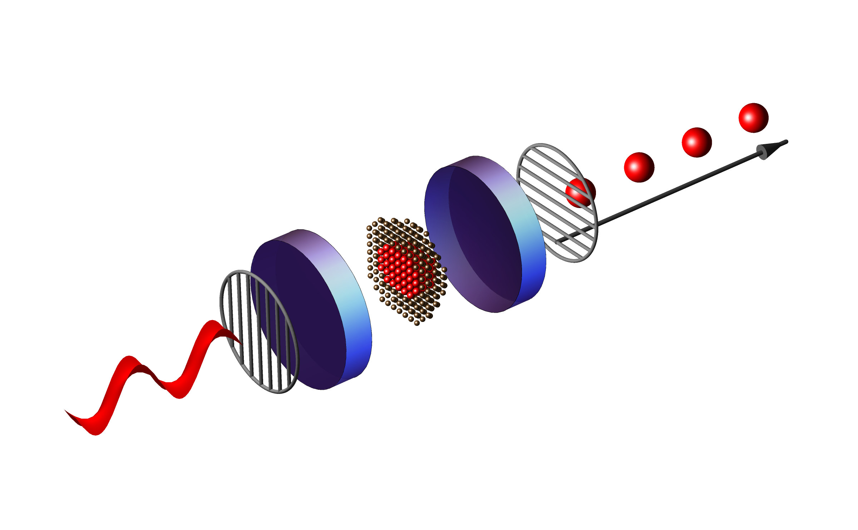
The effect of temporal jitter on single photon indistinguishability
Andrea Maccarinelli 5/16/2025

Slide 2


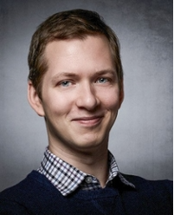
Daily Supervisor:
Mio Poortvliet
Main Supervisor: Dr. Wolfgang Löffler
Second Supervisor: Evert van Nieuwenburg

Slide 3
What is the main goal of my project ?
Boost Single photon indistinguishability
Study the features of the excitation pulses

Slide 4
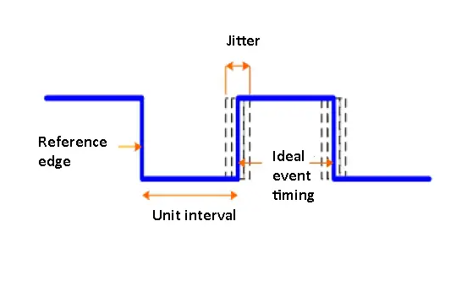
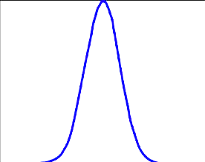
What is the Jitter of a Signal ?
Random Source
Systemic Source
https://www.testandmeasurementtips.com/wp-content/uploads/2017/08/jitter-waveform.jpg
Rev. Sci. Instrum. 95, 054703 (2024); doi: 10.1063/5.0191289

Slide 5
Implementing the Study in Our Setup
CW Laser
EOM
EOM
FPGA

Slide 6
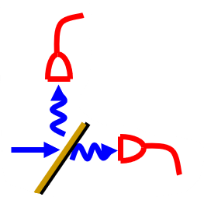
Current Focus – Part I: Hanbury Brown–Twiss on Excitation Pulses
BS
CW Laser
EOM
EOM
SNSPD
FPGA
Time Controller

Slide 7
Why Timing Matters: Understanding Temporal Jitter
Temporal jitter is the deviation in a signal’s timing relative to a reference point, measured at its nominal switching threshold
Two main Categories : Random Jitter & Deterministic Jitter
Randomic Jitter sources linked to a Gaussian pdf
Deterministic Sources are somewhat more similar to systematic errors (e.g. Crosstalk)

